Slide 1

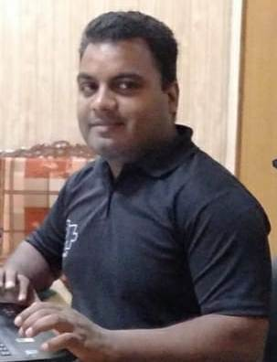


Noida Institute of Engineering and Technology, Greater Noida
(An Autonomous Institute)
School of Computer Science & Engineering in Emerging Technologies
INTRODUCTION TO Web Technology AND WEB HOSTING
Unit: 1
Subject Name:
WEB TECHNOLOGY (Subject
Code is not Assigned) )
Mr. Amar Pal Yadav
Assistant Professor
CSE & ET (AI Department)
Course Details
(B Tech. 5th Sem)
Mr. Amar Pal Yadav Web. Tech. Unit 1

Slide 2

Table of Contents
Name of Subject with code, Course and Subject Teacher
Brief Introduction of Faculty member with Photograph
Evaluation Scheme
Subject Syllabus
Branch wise Applications
Course Objective (Point wise)
Course Outcomes (COs)
Program Outcomes only heading (POs)
COs and POs Mapping
Program Specific Outcomes (PSOs)
Mr. Amar Pal Yadav Web. Tech. Unit 1
2

Slide 3
Conti….
COs and PSOs Mapping
Program Educational Objectives (PEOs)
Result Analysis (Department Result, Subject Result and Individual Faculty Result)
End Semester Question Paper Templates (Offline Pattern/Online Pattern)
Perquisite/ Recap
Brief Introduction about the Subject with videos
Unit Content
Unit Objective
Topic Objective/Topic Outcome
Lecture related to topic
Daily Quiz
Weekly Assignment
Mr. Amar Pal Yadav Web. Tech. Unit 1
3

Slide 4
Conti…
Topic Links
MCQ (End of Unit)
Glossary Questions
Old Question Papers (Sessional + University)
Expected Questions
Recap of Unit
Mr. Amar Pal Yadav Web. Tech. Unit 1
4

Slide 5
Brief introduction of faculty Member
Mr. Amar Pal Yadav
Designation: Assistant Professor CSE&ET (AI )
NIET, Greater Noida (Code-133)
Qualification:
  B.Tech(IT)
  M.Tech(SE), Specialization: Software Engineering
Teaching Experience: 12 years
Research Publication
  Paper Published: 8(International Journal)
Coursera Course
  Coursera Course Completed: 15
Mr. Amar Pal Yadav Web. Tech. Unit 1
5

Slide 6
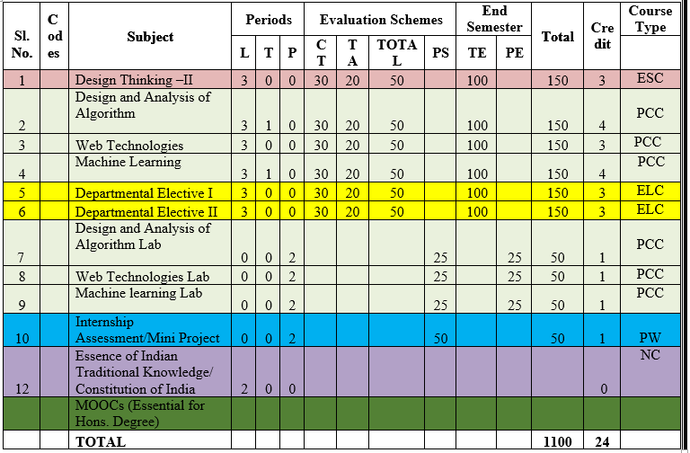
Evaluation Scheme
Mr. Amar Pal Yadav Web. Tech. Unit 1

Slide 7
Syllabus Unit -1
Introduction: Introduction to Web Technology, History of Web and Internet, Connecting to Internet, Introduction to Internet services and tools, Client-Server Computing, Protocols Governing Web, Basic principles involved in developing a web site, Planning process, Types of Websites, Web Standards and W3C recommendations.
Web Hosting: Web Hosting Basics, Types of Hosting Packages, Registering domains, Defining Name Servers, Using Control Panel, Creating Emails in Cpanel, Using FTP Client, Maintaining a Website.
Mr. Amar Pal Yadav Web. Tech. Unit 1

Slide 8
Syllabus Unit -2
HTML: What is HTML, DOM- Introduction to Document Object Model, Basic structure of an HTML document, Mark up Tags, Heading-Paragraphs , Line Breaks, Understand the structure of HTML tables. Lists, Working with Hyperlinks, Image Handling, Understanding Frames and their needs, HTML forms for User inputs. New form Elements- date, number, range, email, search and data list, Understanding audio, video and article tags.
XML: Introduction, Tree, Syntax, Elements, Attributes, Namespaces, Display, HTTP request, Parser, DOM, XPath, XSLT, XQuerry, XLink, Validator, DTD, Schema, Server
Mr. Amar Pal Yadav Web. Tech. Unit 1

Slide 9
Syllabus Unit -3
Concept of CSS 3: Creating Style Sheet, CSS Properties, CSS Styling(Background, Text Format, Controlling Fonts) , Working with block elements and objects , Working with Lists and Tables , CSS Id and Class, Box Model(Introduction, Border properties, Padding Properties, Margin properties) CSS Advanced(Grouping, Dimension, Display, Positioning, Floating, Align, Pseudo class, Navigation Bar, Image Sprites, Attribute sector) , CSS Color, Creating page Layout and Site.
Bootstrap: Introduction, Bootstrap grid system, Bootstrap Components.
Mr. Amar Pal Yadav Web. Tech. Unit 1

Slide 10
Syllabus Unit -4
  JavaScript Essentials: Introduction to Java Script , Javascript Types , Var, Let and Const Keywords, Operators in JS , Conditions Statements , Java Script Loops, JS Popup Boxes , JS
Events , JS Arrays, Working with Arrays, JS Objects ,JS Functions , Using Java Script in Real time , Validation of Forms, Arrow functions and default arguments, Template Strings, Strings methods, Callback functions, Object de-structuring, Spread and Rest Operator, Typescript fundamentals, Typescript OOPs- Classes, Interfaces, Constructor etc. Decorator and Spread Operator,
Difference == & ===, Asynchronous Programming in ES6, Promise Constructor, Promise with Chain, Promise Race.
Mr. Amar Pal Yadav Web. Tech. Unit 1

Slide 11
Syllabus Unit -5
Introduction to PHP, Basic Syntax, Variables & Constants, Data Type, Operator & Expressions, Control flow and Decision making statements, Functions, Strings, Arrays,
Working with files and directories: Understanding file& directory, Opening and closing, a file, Coping, renaming and deleting a file, working with directories, Creating and deleting folder, File Uploading & Downloading.
Session & Cookies: Introduction to Session Control, Session Functionality What is a Cookie, Setting Cookies with PHP. Using Cookies with Sessions, Deleting Cookies, Registering Session variables, Destroying the variables and Session.
Mr. Amar Pal Yadav Web. Tech. Unit 1

Slide 12
Text Books
Text books:
1. Steven M. Schafer, “HTML, XHTML, and CSS Bible, 5ed”, Wiley India
2. Ian Pouncey, Richard York, “Beginning CSS: Cascading Style Sheets for Web Design”, Wiley India
Mr. Amar Pal Yadav Web. Tech. Unit 1

Slide 13
Branch Wise Applications
Sample Applications
Desktop GUI Applications
Mobile Applications
Enterprise Applications
Scientific Applications
Web-based Applications
Cloud-based Applications
Web servers and Application servers
Software Tools
Mr. Amar Pal Yadav Web. Tech. Unit 1

Slide 14
Course Objective
This course covers different aspect of web technology such as HTML, CSS, and issues of web technology, client and server side issue.
The general objectives of this course are to provide fundamental concepts of Internet; Web Technology and Web Programming.
Students will be able to build a proper responsive website.
Mr. Amar Pal Yadav Web. Tech. Unit 1

Slide 15
Course Outcome
At the end of the semester, student will be able to:
Course Outcomes (CO) | CO Description | Blooms’ Taxonomy
CO1 | Recalling the basic facts and explaining the basic ideas of Web technology and web hosting. | K1, K2
CO2 | Applying and creating various HTML5 semantic elements and application with working on HTML forms for user input. | K3, K6
CO3 | Understanding and applying the concepts of Creating Style Sheet (CSS)3 and bootstrap. | K2, K3
CO4 | Analysing and implementing concept of Java Script and its applications. | K4, K6
CO5 | Creating and evaluating dynamic web pages using the concept of PHP | K5, K6
Mr. Amar Pal Yadav Web. Tech. Unit 1

Slide 16
Program Outcome
1. Engineering knowledge:
2. Problem analysis:
3. Design/development of solutions:
4. Conduct investigations of complex problems:
5. Modern tool usage:
6. The engineer and society:
7. Environment and sustainability:
8. Ethics:
9. Individual and team work:
10. Communication:
11. Project management and finance:
12. Life-long learning
Mr. Amar Pal Yadav Web. Tech. Unit 1

Slide 17
CO-PO Mapping
Mapping of Course Outcomes and Program Outcomes:
Subject Code is Not Assigned | PO1 | PO2 | PO3 | PO4 | PO5 | PO6 | PO7 | PO8 | PO9 | PO10 | PO11 | PO12
 | 3 | 2 | 2 | 1 | 1 | 1 | 1 | 1 | 3 | 3 | 2 | 3
 | 3 | 2 | 3 | 1 | 3 | 2 | 2 | 1 | 3 | 3 | 3 | 3
 | 3 | 2 | 3 | 2 | 3 | 2 | 2 | 2 | 3 | 3 | 2 | 3
 | 3 | 3 | 3 | 2 | 3 | 2 | 2 | 2 | 3 | 3 | 2 | 3
 | 3 | 3 | 3 | 2 | 3 | 2 | 2 | 2 | 3 | 3 | 2 | 3
Average | 3 | 2.4 | 2.8 | 1.6 | 2.6 | 1.8 | 1.8 | 1.6 | 3 | 3 | 2.2 | 3
Mr. Amar Pal Yadav Web. Tech. Unit 1

Slide 18
Program Specific Outcomes
PSO1: Apply Artificial Intelligence and its applications to design intelligent systems for the betterment of society.
PSO2: Develop AI-based innovative solutions demonstrating research, entrepreneurship, professional ethics, and communication skills.
PSO3: Demonstrate competency in AI by working in a team and engaging in life-long learning.
Mr. Amar Pal Yadav Web. Tech. Unit 1

Slide 19
COs and PSOs Mapping
Mapping of Program Specific Outcomes and Course Outcomes:
Course Outcomes | Program Specific Outcomes
 | PSO1 | PSO2 | PSO3
 | 3 | 3 | 2
 | 3 | 3 | 3
 | 3 | 3 | 2
 | 3 | 2 | 3
 | 3 | 2 | 2
AVG | 3 | 2.6 | 2.4
Mr. Amar Pal Yadav Web. Tech. Unit 1

Slide 20
Program Educational Objectives
PEO1: Engage in successful professional practices in the area of Artificial Intelligence and pursue higher education and research.
PEO2: Demonstrate effective leadership and communicate as an individual and as a team in the workspace and society.
PEO3: Pursue life-long learning in developing AI-based innovative solutions for the betterment of society.
Mr. Amar Pal Yadav Web. Tech. Unit 1

Slide 21
Result Analysis
New Batch in CSE&ET
Mr. Amar Pal Yadav Web. Tech. Unit 1

Slide 22
End Semester Question Paper Template
B TECH
(SEM-V) THEORY EXAMINATION 20__-20__
Time: 3 Hours Total Marks: 100
Note: 1. Attempt all Sections. If require any missing data; then choose suitably.
SECTION A
Attempt all questions in brief. 1 x 10 = 10
Q.No. | Question | Marks | CO
1 |  | 1
2 |  | 1
. |  | .
10 |  | 1
Mr. Amar Pal Yadav Web. Tech. Unit 1

Slide 23
End Semester Question Paper Templates
2. Attempt of the following: 5 x 2 = 20
SECTION B
3. Attempt any five part of the following: 5 x 6 = 30
Q.No. | Question | Marks | CO
1 |  | 2
2 |  | 2
“”” |  | ‘”
5 |  | 2
Q.No. | Question | Marks | CO
1 |  | 6
. |  | 6
7 |  | 6
Mr. Amar Pal Yadav Web. Tech. Unit 1

Slide 24
End Semester Question Paper Templates
4. Attempt any one part of the following: 1 x 10 = 10
5. Attempt any one part of the following: 1 x 10 = 10
6. Attempt any one part of the following: 1 x 10 = 10
Q.No. | Question | Marks | CO
1 |  | 10
2 |  | 10
Q.No. | Question | Marks | CO
1 |  | 10
2 |  | 10
Q.No. | Question | Marks | CO
1 |  | 10
2 |  | 10
Mr. Amar Pal Yadav Web. Tech. Unit 1

Slide 25
End Semester Question Paper Templates
7. Attempt any one part of the following: 1 x 10 = 10
8. Attempt any one part of the following: 1 x 10 = 10
Q.No. | Question | Marks | CO
1 |  | 10
2 |  | 10
Q.No. | Question | Marks | CO
1 |  | 10
2 |  | 10
Mr. Amar Pal Yadav Web. Tech. Unit 1

Slide 26
Prerequisite
Basic Knowledge of any programming language like C/C++/Python/Java.
Familiarity with basic concepts of Internet.
Mr. Amar Pal Yadav Web. Tech. Unit 1

Slide 27
Brief Introduction About The Subject
Web technologies are the various tools and techniques that are utilized in the process of communication between different types of devices over the internet.
To understand this term in a better manner, let’s break it down into two pieces: ‘web’ and ‘technology’.
The web, in this case, refers to the World Wide Web, more commonly known as WWW.
It first came into being in 1989 when famous scientist and engineer, Tim Berners-Lee, came up with an efficient mechanism to share resources between scientists all over the world.
https://www.youtube.com/results?search_query=Web+Technonogies
Mr. Amar Pal Yadav Web. Tech. Unit 1

Slide 28
Unit 1 Content
Introduction:
  Introduction to Web Technology
  History of Web and Internet
  Connecting to Internet
  Introduction to Internet services and tools
  Client-Server Computing, Protocols Governing Web
  Basic principles involved in developing a web site
  Planning process
  Types of Websites
  Web Standards and W3C recommendations,
Mr. Amar Pal Yadav Web. Tech. Unit 1

Slide 29
Unit 1 Content(cont1..)
Web Hosting:
  Web Hosting Basics
  Types of Hosting Packages
  Registering domains
  Defining Name Servers
  Using Control Panel
  Creating Emails in Cpanel
  Using FTP Client
  Maintaining a Website.
Mr. Amar Pal Yadav Web. Tech. Unit 1

Slide 30
Unit Objective
Objective of Unit 1:
  To learn about web development strategies with protocols governing web and internet services and tools.
  To understand the basic concepts to develop the website as per web standards and W3C recommendations.
  To understand web hosting and web hosting packages.
  To understand to register a domain and maintain web servers.
Mr. Amar Pal Yadav Web. Tech. Unit 1

Slide 31
Introduction to Web Technology
Web Technology refers to the various tools and techniques that are utilized in the process of communication between different types of devices over the internet.
A web browser is used to access web pages.
Web browsers can be defined as programs that display text, data, pictures, animation, and video on the Internet.
Mr. Amar Pal Yadav Web. Tech. Unit 1

Slide 32
Classification of Web technology
World Wide Web (WWW)
Web Browser
Web Server
Web Pages
Web Development
Mr. Amar Pal Yadav Web. Tech. Unit 1

Slide 33
History of Web development and Internet
World Wide Web
  The World Wide Web is a system of interlinked hypertext documents accessed via the Internet. Web is a huge collection of pages of information linked to each other around the globe.
History of WWW:
  WWW is created by Sir Tim Berners Lee in 1989 at CERN in Geneva.
  In 1990, the first text only browsers were setup and CERN scientist.
  To transfer HTML document to remote sites a new protocol was devised called HTTP (Hyper Text Transfer Protocol).
Mr. Amar Pal Yadav Web. Tech. Unit 1

Slide 34
Contd….
In the fall of 1991, conference goes around the world started hearing about
the promise but sparks still were not flying.
In 1993, there are only about 50 websites world wide.
A browser that allowed user to take advantage of the web’s graphical
capabilities was developed at the National center for Super Computing application (NCSA).
NCSA called the browser Mosaic.
Mr. Amar Pal Yadav Web. Tech. Unit 1

Slide 35
Connecting to Internet
When determining which type of Internet speed and Internet connection type is right for you or your family, it's important to understand the distinction between each connection.
In today's age, there are numerous ways to connect laptops, desktops, mobile phones, gaming consoles, e-readers and tablets to the Internet.
  MOBILE
  WIFI HOTSPOTS
  DIAL-UP
  BROADBAND
  DSL(DIGITAL SUBSCRIBER LINE)
  CABLE
  SATELLITE
Mr. Amar Pal Yadav Web. Tech. Unit 1

Slide 36
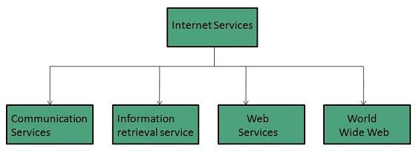
Introduction to Internet services and tools
Internet Services allows us to access huge amount of information such as text, graphics, sound and software over the internet.
Mr. Amar Pal Yadav Web. Tech. Unit 1

Slide 37
Protocols Governing Web
  Protocol
    A protocol is a set of rules to communicate applications to each other.
    A protocol is the interface required for communicating the different applications
  Classification of Protocols
      HTTP
      TCP/IP
      FTP
      SMTP
      TELNET
Mr. Amar Pal Yadav Web. Tech. Unit 1

Slide 38
Protocols Governing Web(cont1..)
      HTTP Protocol
        HTTP is the primary protocol used to distribute information on the web
        Initial HTTP 0.9 does not allow for content typing and does not have provisions for supplying meta- information.
        Content Typing is to identify the type of data being transferred.
        Meta Information is supplemental data, such as environment variables that identify the client’s computer
Mr. Amar Pal Yadav Web. Tech. Unit 1

Slide 39
Protocols Governing Web(cont1..)
TCP/IP
  It is a set of rules that an application can use to package its information for sending across the networks of networks.
FTP
  FTP uses TCP to create a virtual connection for control information and then creates a separate TCP connection for data transfers.
  It is used to transfer the files over networks.
Mr. Amar Pal Yadav Web. Tech. Unit 1

Slide 40
Protocols Governing Web(cont1..)
SMTP
    It is an Internet standard for electronic mail (e- mail) transmission across Internet Protocol (IP) networks.
Telnet
    This protocol used to remotely login into another system .
    This is used to browse file and directories on the remote system.
Mr. Amar Pal Yadav Web. Tech. Unit 1

Slide 41
Types Of Websites
Website:
  A website is simply a collection of interlinked web pages.
Classification of Website
  Corporate Website
  Individual website
Mr. Amar Pal Yadav Web. Tech. Unit 1

Slide 42
Websites
Corporate Website:
  In this, there is certain no. of persons, who develop their website for a particular organization.
  The corporate website are formed when group of people have common interest and objective.
  The purpose of this website is to convey the information of organization to all over the world
Mr. Amar Pal Yadav Web. Tech. Unit 1

Slide 43
Websites(cont1..)
Individual Website
  Personal web pages are world wide web pages created by an individual to contain content of a personal nature rather than content pertaining to a company, organization or institution.
  It is just like profile management system.
  In this type of website an individual wants to develop website for
  hi-projection, career growth etc.
Mr. Amar Pal Yadav Web. Tech. Unit 1

Slide 44
Web Applications
Web application is a kind of application that can be through the web browser over the internet.
Web applications may include simple office software word processors, Google docs, project management, computer-aided design, online spreadsheets, and presentation tools.
Some common scripting languages are used to create web applications such as JSP, ASP and PHP.
Web applications interact with program variables ,spreadsheets and databases using user input for creating the dynamic web content.
Mr. Amar Pal Yadav Web. Tech. Unit 1

Slide 45
Web Applications(cont1..)
Examples of Web Application
  Airline Reservation System.
  Message Boards.
  Shopping Cart.
  Net-banking.
Mr. Amar Pal Yadav Web. Tech. Unit 1

Slide 46
Writing a Web Projects
Objective of above Topic:
To developed web project and understand the concepts of web project development differs from traditional web projects
Phases of writing the web projects
    Write a project mission statement
        Write the specific mission statement that you want to do.
    Identify Objectives
      Specific
      Measurable
      Attainable
      Realistic
      Time limited
Mr. Amar Pal Yadav Web. Tech. Unit 1

Slide 47
Writing a Web Projects(cont1..)
Phases of writing the web projects(cont..)
    Identify your target users
      The matter of a website will be determined by the users whom you want to visit the site. This is totally depend upon
        Market research
        Focus group
        Understanding the audiences
    Determine the scope
        By supporting documents and client’s approval.
Mr. Amar Pal Yadav Web. Tech. Unit 1

Slide 48
Writing a Web Projects(cont1..)
Phases of writing the web projects(cont..)
  Budget
      Assumption for budgets.
      Budget categories.
      Determine hidden costs and tools.
    Planning issues:
    Discuss client’s existing information system.
    Project team and developing infrastructure.
    Where the website will place.
Mr. Amar Pal Yadav Web. Tech. Unit 1

Slide 49
Connecting To Internet
Telephone
  A Telephone is a device that converts voice communication into electrical signals that can be transferred to other telephones and heard.
  Telephones enable people to communicate with other people all over the world and is widely credited as being first invented by Alexandra Graham Bell in 1876.
  There are three basic phones in use today. The classic corded telephone, which could be rotary dial like or have buttons, the cordless or wireless phone, and the cell phone
Mr. Amar Pal Yadav Web. Tech. Unit 1

Slide 50
Connecting To Internet(cont1..)
Cable
A cable is one or more wires covered in a plastic covering that connects a computer to a power source or other device.
Two Types of computer cables
    A data cable is a cable that provides communication between devices.
    For example, the data cable that connects your monitor to your computer and allows your computer to display a picture on the monitor such as SATA and USB etc.
    A power cable is any cable that powers the device.
Mr. Amar Pal Yadav Web. Tech. Unit 1

Slide 51
Connecting To Internet(cont1..)
Types of Cables:
    AT - Used with early keyboard.
    ATA - Used with hard drives and disc drives.
    CAT5 - Used with network cards.
    Coaxial -Used with TV and Projectors.
    DVI - Used with Monitors Projectors, and other display
    E-SATA - Used with external drives.
Mr. Amar Pal Yadav Web. Tech. Unit 1

Slide 52
Connecting To Internet(cont1..)
Types of Cable
    MDI - Used with musical keyboards and other equipment.
    Mini Plug - Used with headphone, microphone and speakers.
    Molex - Power cable used inside your computer.
Mr. Amar Pal Yadav Web. Tech. Unit 1

Slide 53
Connecting To Internet(cont1..)
Satellite Connection
  A satellite connection uses broadband but does not require cable or phone lines.
  It connects to the Internet through satellites orbiting the Earth.
  It can be used almost anywhere in the world, but the connection may be affected by weather patterns.
Mr. Amar Pal Yadav Web. Tech. Unit 1

Slide 54
Connecting To Internet(cont1..)
Satellite Connection(cont..)
  A satellite connection also relays data on a delay, so it is not the best option for people who use real-time applications, like gaming or video conferencing.
  A satellite Internet connection is an arrangement in which the upstream (outgoing) and the downstream (incoming) data are sent from, and arrive at, a computer through a satellite.
Mr. Amar Pal Yadav Web. Tech. Unit 1

Slide 55
Introduction to Internet services and tools
Introduction To Internet Services
  Common Protocol Used To Provide Internet Services
    The File Transfer Protocol (FTP) is a standard network protocol used to transfer computer files from one host to another host over a TCP-based network, such as the Internet
    Telnet is a network protocol used on the Internet or local area networks to provide a bidirectional interactive text-oriented communication facility using a virtual terminal connection.
Mr. Amar Pal Yadav Web. Tech. Unit 1

Slide 56
Introduction to Internet services and tools
Introduction To Internet Services(cont..)
RSH Remote Shell allows you to send single commands to the remote server.
RCP Remote Copy provides the capability to copy files to and from the remote server without the need to resort to FTP or NFS (Network File System, the UNIX form of folder sharing
NNTP(Network News)-( Reading and posting USENET news)
Mr. Amar Pal Yadav Web. Tech. Unit 1

Slide 57
Introduction to Internet services and tools
Introduction To Internet Services(cont..)
HTTP(Hypertext Transfer Protocol)-(Transferring documents on the Web)
SMTP(Simple Mail Transfer Protocol)- (Sending mail)
POP3(Post Office Protocol)- (Reading Mail)
Post Office Protocol (POP) protocol used by local e-mail clients to retrieve e-mail from a remote server over a TCP/IP connection.
Mr. Amar Pal Yadav Web. Tech. Unit 1

Slide 58
Introduction to client-server computing
  Client/Server Definition
    In client/server computing “server software accepts requests for data from client software and returns the results to the client”
  Elements of C-S Computing
        A Client
        A Server
        And a network
        In client-server computing major focus is on SOFTWARE
Mr. Amar Pal Yadav Web. Tech. Unit 1

Slide 59
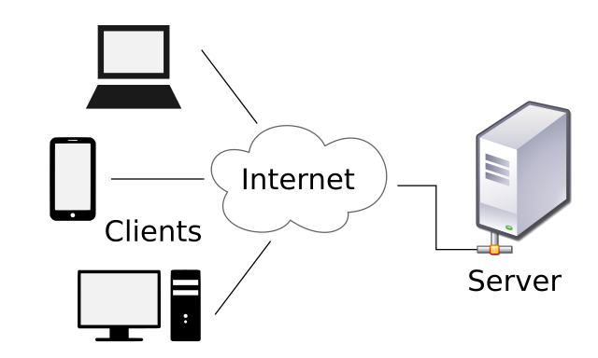
Introduction to client-server computing
      A Client/Server Computing
Mr. Amar Pal Yadav Web. Tech. Unit 1

Slide 60
Introduction to client-server computing
Categories of Server
  File Server
    File Servers manage a work group’s application and data files, so that they may be shared by the group.
  Data Server
    It used only for data storage and management
  Compute Server
Mr. Amar Pal Yadav Web. Tech. Unit 1

Slide 61
Introduction to client-server computing
    Categories of Server(cont..)
Database Server
    Accepts requests for data, retrieves the data from its database
Communication Server
    Provides gateway to other LANs, networks & Computers
Mr. Amar Pal Yadav Web. Tech. Unit 1

Slide 62
Previous Topics: Recap
Protocols governing web, and internet services and tools that connect to the internet.
It was also discussed about the history of web.
We had also discuss Cyber Laws and Website and its classification
Mr. Amar Pal Yadav Web. Tech. Unit 1

Slide 63
Previous Topics: Recap(Cont..)
The above topic was focused on the Web Application with its examples and phases.
It was also discussed about the connection of Internet through:-
  Telephone
  Cables and its types
  Satellite Connection.
We have also discussed about the client server computing and Categories of Server.
How to write the web project in the previous topic
Mr. Amar Pal Yadav Web. Tech. Unit 1

Slide 64
Topic Objective/Outcome
Topics: Web Hosting: Web Hosting Basics, Types of Hosting Packages, Registering domains, Defining Name Servers, Using Control Panel, Creating Emails in Cpanel, Using FTP Client, Maintaining a Website. (CO1 )
Objective of the above topics:
  To know the basics of web hosting and hosting packages.
  To get the knowledge about registering domains and DNS.
  To learn how FTP is used in a web server and how to maintain a website?
Mr. Amar Pal Yadav Web. Tech. Unit 1

Slide 65
Web Hosting Basics
When a hosting provider allocates space on a web server for a website to store its files, they are hosting a website.
Web hosting makes the files that comprise a website (code, images, etc.) available for viewing online.
web hosting is the process of renting or buying space to house a website on the World Wide Web.
Website content such as HTML, CSS, and images has to be housed on a server to be viewable online.
Web hosting service providers have the servers, connectivity, and associated services to host websites.
Choosing the right hosting plan will mean having access to the right allocation of resources to keep your website loading quickly and reliably for your visitors.
Mr. Amar Pal Yadav Web. Tech. Unit 1

Slide 66
Types of Hosting Packages
There are the six types of web hosting:
Shared hosting
Virtual private server (VPS) hosting
Dedicated server hosting
Cloud hosting
Managed hosting
Colocation
Shared hosting
  Perfect for entry-level website hosting
  website will be stored on the same server as multiple other websites.
  With a shared hosting plan, all domains share the same server resources, such as RAM (Random Access Memory) and CPU (Central Processing Unit).
  However, because all resources are shared, the cost of shared hosting plans are relatively low, making them an excellent option for website owners in their beginning stages.
  Shared hosting plans often comes with many helpful tools such as: website builders(opens in new tab), WordPress hosting(opens in new tab), and the ability to email clients(opens in new tab).
Mr. Amar Pal Yadav Web. Tech. Unit 1

Slide 67

Types of Hosting Packages
Virtual private server (VPS) hosting
A VPS hosting plan is the ultimate middle ground between a shared server and a dedicated server.
It’s ideal for website owners that need more control, but don’t necessarily need a dedicated server.
VPS hosting provides website owners with more customization and storage space, but still they are not able to handle incredibly high traffic levels or spikes in usage meaning that the site performance can still be affected by other sites on the server.
VPS hosting is used by website owners who want dedicated hosting but don’t have the technical knowledge needed.
VPS hosting offers the cost benefits of shared hosting with the control of dedicated hosting.
Mr. Amar Pal Yadav Web. Tech. Unit 1

Slide 68
Types of Hosting Packages
Dedicated server hosting
Dedicated hosting gives website owners the most control over the server that their website is stored on.
Customer has full root and admin access, so he can control everything from security to operating system that you run.
Dedicated servers cost are one of the most expensive web hosting options.
Used by website owners with high levels of website traffic, and those who are in need of complete control of their servers.
A high level of technical expertise is required for the installation and ongoing management of the server.
Cloud hosting
It’s a hosting solution that works via a network and enables companies to consume the computing resource like a utility.
This allows users to employ as many resources as they need without having to build and maintain their own computing infrastructure.
Cloud-based hosting is scalable, meaning your site can grow over time, using as many resources as it requires and while the website owner only pays for what they need.
Mr. Amar Pal Yadav Web. Tech. Unit 1

Slide 69
Types of Hosting Packages
Managed hosting
Hosting companies provide technical services such as hardware and software setup and configuration, maintenance, hardware replacement, technical support, patching, updating and monitoring.
With managed hosting, the provider looks after the day-to-day management of the hardware, operating systems and standardized applications.
Colocation
Instead of keeping servers in-house or at a private data center, you may choose to ”‘co-locate” your equipment by renting space in a colocation center.
he center will provide the power, bandwidth, IP address and cooling systems that your server requires. Space is rented out in racks and cabinets.
Colocation gives access to higher levels of bandwidth than a normal office server room at a much lower cost.
You’re left to your own devices (literally) and will be expected to take care of everything including the hardware, software and services.
Mr. Amar Pal Yadav Web. Tech. Unit 1

Slide 70
Registering domains
Your company needs a website, which means it needs a domain name.
First step is registering a domain name.
Once you've decided to build a website, you need to make an important decision i.e. What's your domain name going to be?
Domain name is the web address by which all your customers will find you.
Domain name is a numeric internet address, Every computer on the internet has a unique internet protocol (IP) number. For example, the IP number for the domain name whitehouse.gov is 104.109.178.94.
Anyone can buy a domain name,To do so, you visit a domain name registrar, such as A2, GoDaddy, or Namecheap, key in the domain you want to buy, and pay a fee.
You can't buy just any domain, of course—only one that isn't already registered by another person or business and that bears a valid domain suffix.
Mr. Amar Pal Yadav Web. Tech. Unit 1

Slide 71
Defining Name Servers
Name servers translate the domain name into an IP address, connecting information that’s easy for humans to understand with information that’s easy for computers to understand.
Mr. Amar Pal Yadav Web. Tech. Unit 1

Slide 72
Using Control Panel
Control panel is a popular tool used to manage your hosting package.
You can do all sorts of things with it: manage your purchased domain names, install applications, create and manage email accounts, upload website’s files etc.
There are many types of panels on the internet, all of them have different design and scope of features:
  cPanel
  Plesk
  hPanel
  Direct Admin
  Webmin
  ISPmanager
Mr. Amar Pal Yadav Web. Tech. Unit 1

Slide 73
Creating Emails in Cpanel
Log in to cPanel.
Look for the Email section, then click Email Accounts
Click the + Create button located on the right-hand side.
Enter the required details to create a new email account on the next page.
  Domain: Select the domain where you wish to create the new email account.
  Username: Enter your email username.
  Password: Enter your email password.
You will notice the Optional Settings. Click the Edit Settings button to customize the new email account. This is where you can set your email's storage space.
Click + Create to finalize
Mr. Amar Pal Yadav Web. Tech. Unit 1

Slide 74
FTP
File Transfer Protocol (FTP) is a network protocol used to transfer data from one computer to another through a network, such as the Internet.​
FTP is a file transfer protocol for exchanging and manipulating files over​
any TCP-based computer network.​
A FTP client may connect to a FTP server to manipulate files on that server.​
The FTP protocol also includes commands which can be use to execute operations on any remote computer. For example, to change directories, show folder contents, create folders or delete files. It is built on a client- server architecture.​
FTP allows to utilize separate control and data connections between the client and server applications. It helps to solve the issue of different end host configurations.​
Mr. Amar Pal Yadav Web. Tech. Unit 1

Slide 75
FTP
Features of FTP​
Auto re-get or Resuming​
A user interface that shows both local and remote files​
Allows monitoring of file transfers​
Helps you to set up and save multiple FTP sessions​
Allows for uploading multiple files at one time Support for numerous​
flavors of FTP and SFTP​
FTP operates in a client/server environment, meaning that the remote machine is configured as a server. So, it waits for the other machine to request a service from it.​
The FTP protocol can also perform actions like creating and deleting directories, listing files, deleting and renaming files, etc.​
Mr. Amar Pal Yadav Web. Tech. Unit 1

Slide 76
Using FTP Client
By using an FTP client, you can upload, download, and manage files on our server. FileZilla is one of the most commonly used FTP clients.
How to Connect to FTP Using FileZilla?
Download and install FileZilla onto your personal computer.
Get your FTP settings (these steps use our generic settings)
Open FileZilla.
Fill out the following information:
  Host: ftp.mydomain.com or ftp.yourdomainname.com
  Username: FTP username (Same as your hosting account username or the FTP account created)
  Password: FTP password (Your FTP account password)
Click Quickconnect.
FileZilla will attempt to connect. It will display Directory Listing Successful once you are connected.
Mr. Amar Pal Yadav Web. Tech. Unit 1

Slide 77
Maintaining a Website
Website maintenance is the act of regularly checking your website for issues and mistakes and keeping it updated and relevant.
This should be done on a consistent basis in order to keep your website healthy, encourage continued traffic growth, and strengthen your SEO and Google rankings.
Keeping a website well maintained and attractive is important to companies big and small in order to engage and retain customers.
Following website maintenance tasks that should be completed regularly:
  Check that all of your pages are loading without errors
  Run a backup and make sure a previous version of your site is stored
  Make updates to website software and plugins
  Check that all of your forms are running properly
  Remove any spam comments from pages and posts
  Check your pages to see if there are any broken links
  Search for 404 errors and fix or redirect
  Write one or more blog posts to keep your community engaged and encourage SEO traffic.
Mr. Amar Pal Yadav Web. Tech. Unit 1

Slide 78
Maintaining a Website
Website maintenance tsk to be done Monthly
Check the load speed of your website and ensure that nothing is bogging it down
Review your security scans and make sure nothing is out of place
Analyze website statistics from the previous month
Check your blog to see if there are any articles that could be updated
Website maintenance tsk to be done quarterly
Review your website design and structure – can be it improved?
Check graphics and images – should anything be updated?
Review SEO and meta titles and descriptions to ensure they are as effective as possible
Test and tweak popups, forms, and calls to action
Review your workload for efficiencies to see if anything can be automated
Test your website on all devices and browsers to see if it displays correctly
Review advertising and marketing campaigns to see if anything needs to be changed or updated.
Restore a previous version of the website to check your backup health
Mr. Amar Pal Yadav Web. Tech. Unit 1

Slide 79
Maintaining a Website
Website maintenance task to be done Yearly
Update any reference to the current year
Review each page for content accuracy, grammar, typos, and relevancy
Check any active email addresses and see if any are excessive and can be deleted
Ensure that your website domain name is renewed
Consider whether a website design update is due
Review all of your top performing blog articles and see if they can be updated with new content
Mr. Amar Pal Yadav Web. Tech. Unit 1

Slide 80
Daily Quiz
What are shared on the Internet and are called as Web pages?
(A) Programs
(B) Cables
(C) Hypertext documents
(D) None
What is the name of the location address of the hypertext documents?
(A) Uniform Resource Locator
(B) Web server
(C) File
(D) Web address
Mr. Amar Pal Yadav Web. Tech. Unit 1

Slide 81
Daily Quiz(cont..)
Which of the following is true about public access modifier?
A - Variables, methods and constructors which are declared public can be accessed by any class.
B - Variables, methods and constructors which are declared public can be accessed by any class lying in same package.
C - Variables, methods and constructors which are declared public in the superclass can be accessed only by its child class.
D - None of the above.
Which program is used by web clients to view the web pages?
(A) Web browser
(B) Protocol
(C) Web server
(D) Search Engine
Mr. Amar Pal Yadav Web. Tech. Unit 1

Slide 82
Daily Quiz(Cont..)
The following “Things to consider” while planning a website:
(i) Purpose of website (ii) Target audience
(iii) Website contents (iv) All of these
(b) The initial stage of planning your website is to:
(i) Identify the target audience (ii) Identity the Purpose of the Site
(iii) Budgeting (iv) Prepare Blue Print
(c) Which of following are the are web site design consideration and principles?
(i) Easy to read (ii)Easy to navigate
(iii) Quick download (iv) All of these
Mr. Amar Pal Yadav Web. Tech. Unit 1

Slide 83
Weekly Assignment
Explain the following: [CO1]
  URL
  domain name space
  Domain name server
Explain the term protocol. List all the commonly used web protocols. [CO1]
Explain the role of web server on the internet. [CO1]
Explain the working of web with proper diagram. [CO1]
Give examples of each: static and dynamic website.[CO1]
Describe domain name space and domain name server. [CO1]
Describe all the steps of web site hosting. [CO1]
Explain Hypertext and Hypermedia. [CO1]
What do you understand by a markup language? List all the types of markup languages. [CO1]
Explain HTML with basic structure of an HTML document. [CO1]
Mr. Amar Pal Yadav Web. Tech. Unit 1

Slide 84
MCQ s
Who is making web standards
Netscape
Microsoft
WWWC
Range of Heading tags in HTML
<h1> to <h3>
<h1> to <h8>
<h1> to <h6>
<h1> to <h9>
What does HTML stand for ?
Hyperlinks and Text Markup Language
Home Tool Markup Language
Hyper Text Markup Language
Home Text Markup Language
Mr. Amar Pal Yadav Web. Tech. Unit 1

Slide 85
MCQ s(Cont..)
Web is a huge collection of ………..of information linked to each other around the globe.
Pages
Website
HTML
Father of WWW
J.T. Thomson
Dennis Ritchie
Tim Berners-Lee
Who is responsible for creating the look and feel of a site?
Creative Lead
Programmer
Analyst
Designer
Mr. Amar Pal Yadav Web. Tech. Unit 1

Slide 86
MCQ s(Cont..)
Which of the following are information retrieval services on the internet?
i) World Wide Web ii) File Transfer Protocol iii) Telnet iv) Email
A) i, ii and iv only
B) ii, iii and iv only
C) i, ii and iii only
D) All i, ii, iii and iv
. ………….. allows remote accessing to the files which contain programs, technical handouts, reports etc.
A) Remote Desktop
B) FTP
C) Telnet
D) Chat
Mr. Amar Pal Yadav Web. Tech. Unit 1

Slide 87
Glossary Questions
………….. allows remote accessing to the files which contain programs, technical handouts, reports etc.
A) Remote Desktop
B) FTP
C) Telnet
D) Chat
……………. is a global hypertext system that was initially developed in 1989 by Tim Berners Lee.
A) FTP
B) Telnet
C) www
D) email
The ……………. application is built with a protocol interpreter, a data transfer, process and user interface.
A) TCP
B) FTP
C) Telnet
D) Chat
Mr. Amar Pal Yadav Web. Tech. Unit 1

Slide 88
Glossary Questions
ARPANET used the concept of packet switching network consisting of subnet and …………… computers.
A) local
B) remote
C) host
D) network
Internet was possible because of the use of the TCP/IP reference model and ……………… protocol stack.
A) FTP
B) TCP/IP
C) DHCP
D) UDP
………………. was created for organizing machines into domains and map hostname onto IP address.
A) Domain Addressing System
B) Domain Naming System
C) Host Naming System
D) Domain Mapping System
Mr. Amar Pal Yadav Web. Tech. Unit 1

Slide 89
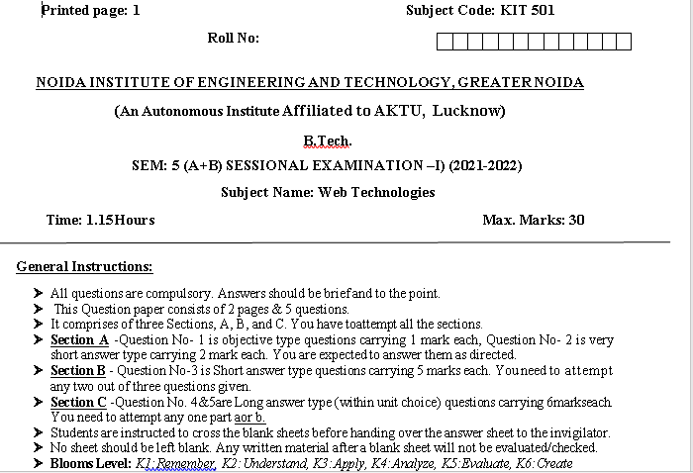
Sessional Papers
Mr. Amar Pal Yadav Web. Tech. Unit 1

Slide 90
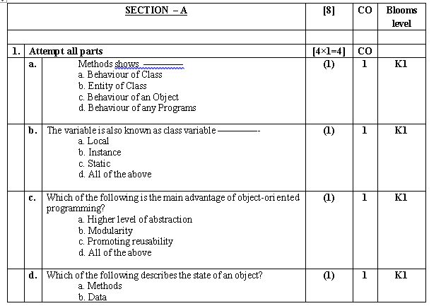
Sessional Papers
Mr. Amar Pal Yadav Web. Tech. Unit 1

Slide 91
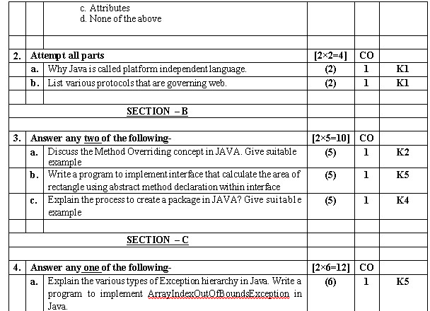
Sessional Papers
Mr. Amar Pal Yadav Web. Tech. Unit 1

Slide 92
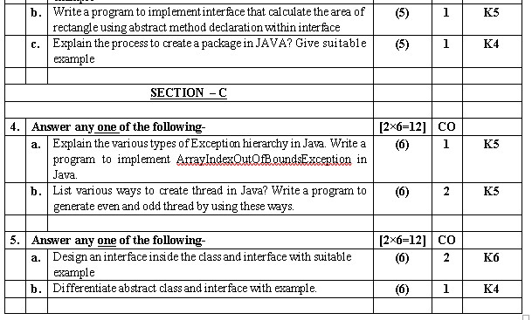
Sessional Papers
Mr. Amar Pal Yadav Web. Tech. Unit 1

Slide 93
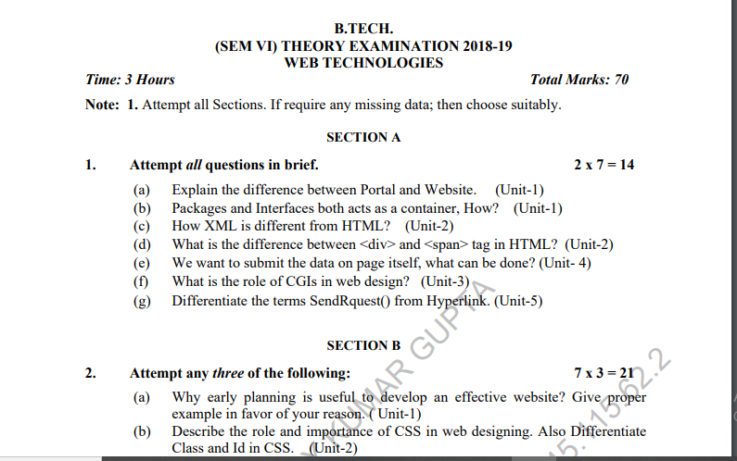
Old Question Paper
Mr. Amar Pal Yadav Web. Tech. Unit 1

Slide 94
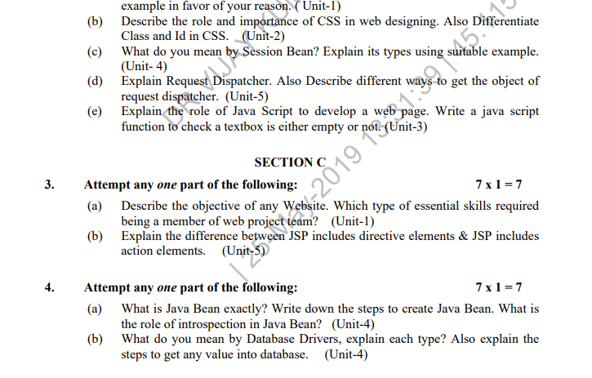
Old Question Paper(cont..)
Mr. Amar Pal Yadav Web. Tech. Unit 1

Slide 95
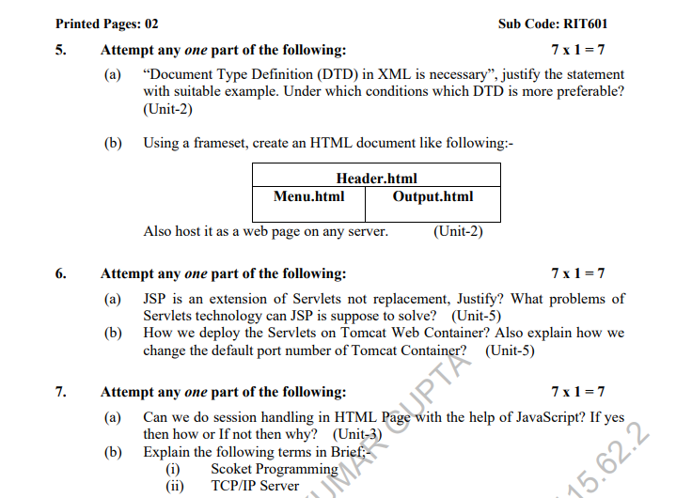
Old Question Paper(cont..)
Mr. Amar Pal Yadav Web. Tech. Unit 1

Slide 96
Expected Questions for University Exam
Discuss the various protocols in details that are governing web
Explain various types of tools available to design a website
Discuss the process involve in web hosting with help of example
Explain the various types server involve in client/server model
Elaborate the complete process for creating Emails in Cpanel.
Discuss various types of hosting packages for registering domains
Mr. Amar Pal Yadav Web. Tech. Unit 1

Slide 97
References
.
Burdman, Jessica, “Collaborative Web Development” Addison Wesley
Xavier, C, “ Web Technology and Design” , New Age International
Ivan Bayross,” HTML, DHTML, Java Script, Perl & CGI”, BPB Publication
Mr. Amar Pal Yadav Web. Tech. Unit 1

Slide 98
Recap of Unit 1
Discussed about the history of web development strategies and protocols governing web with various types of internet services and tools.
Discussed about various types server with the help of client server computing concepts.
Discussed the various type of hosting packages
Discussed about various protocols governing web
Mr. Amar Pal Yadav Web. Tech. Unit 1

Slide 99

Mr. Amar Pal Yadav Web. Tech. Unit 1

